Slide 1
Fahrenheit Co.
Communities
James W. Garrett
Eric Anderson
Rishabh Tewari
Mason Holley
Christopher Bednarz
Zoe Chamlee

Slide 2
Customer Need
Online communities are amassing thousands of members globally
Users are unable to develop deeper relationships with others of similar interests
Increase in connectivity has not decreased feelings of isolation
Existing solutions: Discord, Reddit, Facebook Groups, Nextdoor

Slide 3
Proposed Product
App that shows local communities within a user’s area
User’s may browse a map of the city and select communities he/she wishes to join
Once a community is “discovered” users may join to receive info about news, posts, and events
Once a user leaves an area, they may no longer post but can still browse discovered communities

Slide 4
How Product Solves Need
Increases connectivity within the local scene by:
  Increasing ease of access
  Limiting Scope
Combined this should serve to create tighter knit communities within the local scene.

Slide 5
Technical Requirements
User interface to allow browsing communities
Search function to find new communities
A feed which contains updates from joined communities
Gathering and making use of location based data
Database containing platform content
Server to host the different communities and user profiles
Secure login mechanism
HTTPS

Slide 6
Technical Challenges
Location Locked Communities
  Each community will have a radius based on the city it is created in.
  Each user has their own radius, if these radii intersect, the user will be able to see the community.
Moderation
  Moderation will be handled by the creators of each individual community.
  Moderation tools will be provided.
Cybersecurity
  Bot and spam protection will need to be implemented to prevent harmful attacks.
  Account protection will need to include password encryption and account recovery.

Slide 7
Revenue Model
2 Part Revenue Model
Local Adverts and Ad Spaces
  Local Businesses can by ad spaces
  Encourages Local Business
Monthly Premium Subscriptions
  Pay to block ads
  Post in distant communities

Slide 8
Project Budget
Estimated 10 hours per person of coding
Estimated 10 additional hours to debug
120 work hours on the project total
Average TTU CS major makes about $40.38/hour
$4850 total cost of labor
Time estimates are inflated
Estimated 20 month turn around

Slide 9
Timeline
Phase 1
Decide on the project
Come up with technical specifications, budget, mvp, design specs
Phase 2
UI ~ Frontend (React, Vue, whatever)
Backend ~ MERN, Parse, Firebase
Database~ PostgreSQL, MongoDB, CockroachDB, Redis
Phase 3
Improvements and bugfixes
Shipment

Slide 10
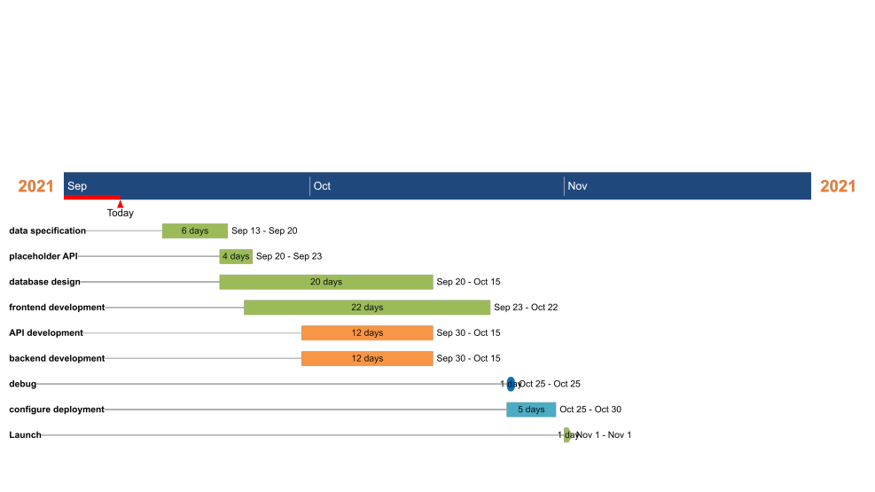

Slide 11
Q&A
Any questions or comments?

Slide 12
Thanks for Listening!

